Slide 1
Computer Graphics
Lecture 3
Line, Modelling and Structures

Slide 2
Display a geometry
How to draw a line on a pixel matrix
Definition of geometrical model
Drawing polygons

Slide 3
Draw a Line

Slide 4
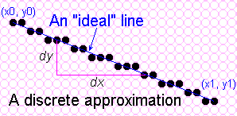
Towards the Ideal Line
We can only do a discrete approximation
Illuminate pixels as close to the true path as possible, consider bi-level display only
  Pixels are either lit or not lit

Slide 5
What is an ideal line
Must appear straight and continuous
  Only possible axis-aligned and 45º lines
Must interpolate both defining end points
Must have uniform density and intensity
  Consistent within a line and over all lines
  What about antialiasing?
Must be efficient, drawn quickly
  Lots of them are required!!!

Slide 6
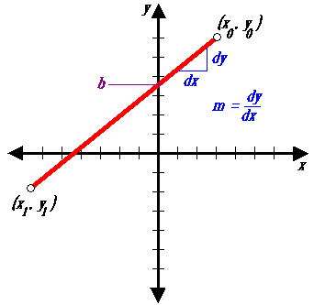
Simple Line
Based on slope-intercept algorithm from algebra:
y = mx + b
Simple approach:
increment x, solve for y
Floating point arithmetic required

Slide 7
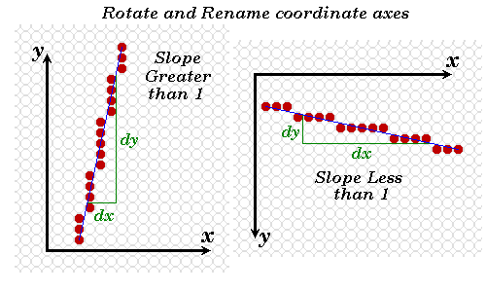
Modify algorithm per octant
OR, increment along x-axis if dy<dx else increment along y-axis

Slide 8
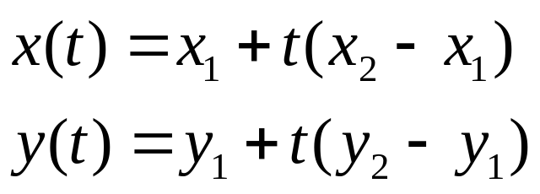
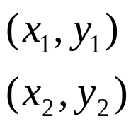
DDA algorithm
DDA = Digital Differential Analyser
  finite differences
Treat line as parametric equation in t :
Start point -
End point -
Notes:
Important algorithm.

Slide 9
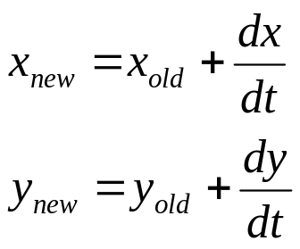
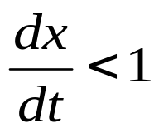
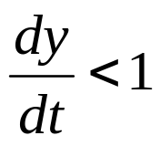
DDA Algorithm
Start at t = 0
At each step, increment t by dt
Choose appropriate value for dt
Ensure no pixels are missed:
  Implies: and
Set dt to maximum of dx and dy

Slide 10
DDA algorithm
line(int x1, int y1, int x2, int y2)
{
float x,y;
int dx = x2-x1, dy = y2-y1;
int n = max(abs(dx),abs(dy));
float dt = n, dxdt = dx/dt, dydt = dy/dt;
x = x1;
y = y1;
while( n-- ) {
point(round(x),round(y));
x += dxdt;
y += dydt;
}
}
n - range of t.

Slide 11
DDA algorithm
Still need a lot of floating point arithmetic.
  2 ‘round’s and 2 adds per pixel.
Is there a simpler way ?
Can we use only integer arithmetic ?
  Easier to implement in hardware.

Slide 12
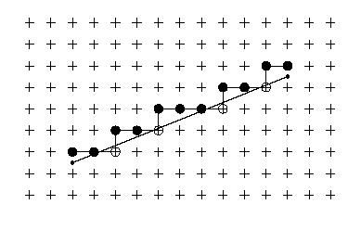
Observation on lines.
while( n-- )
{
draw(x,y);
move right;
if( below line )
move up;
}

Slide 13
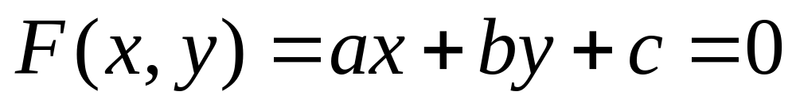
Testing for the side of a line.
Need a test to determine which side of a line a pixel lies.
Write the line in implicit form:
Easy to prove F<0 for points above the line, F>0 for points below.

Slide 14
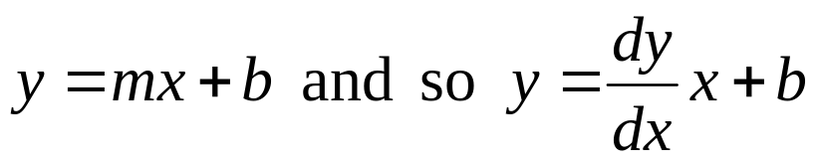
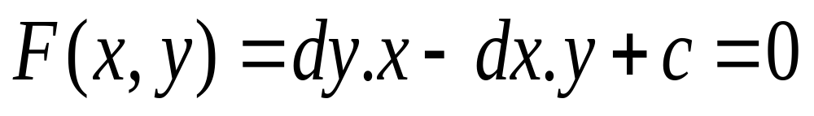
Testing for the side of a line.
Need to find coefficients a,b,c.
Recall explicit, slope-intercept form :
So:

Slide 15
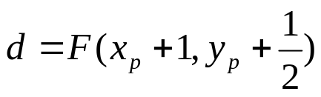
Decision variable.
Evaluate F at point M
Referred to as decision variable
NE
M
E
Previous
Pixel
(xp,yp)
Choices for
Current pixel
Choices for
Next pixel
Notes:
Very important.

Slide 16
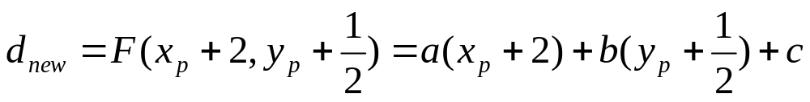
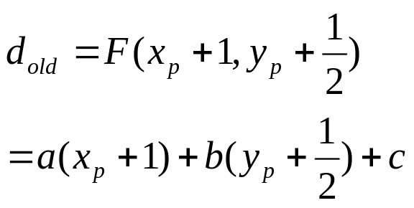
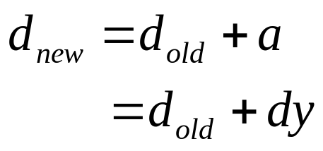
Decision variable.
Evaluate d for next pixel, Depends on whether E or NE Is chosen :
If E chosen :
But recall :
NE
M
E
So :
Previous
Pixel
(xp,yp)
Choices for
Next pixel
Choices for
Current pixel

Slide 17
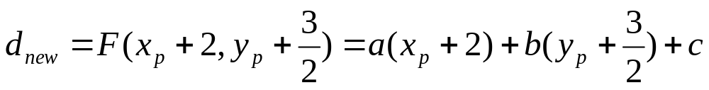
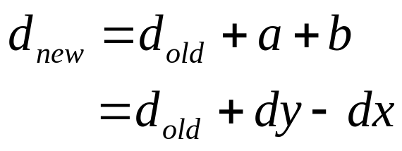
Decision variable.
If NE was chosen :
M
So :
NE
E
Previous
Pixel
(xp,yp)
Choices for
Next pixel
Choices for
Current pixel

Slide 18
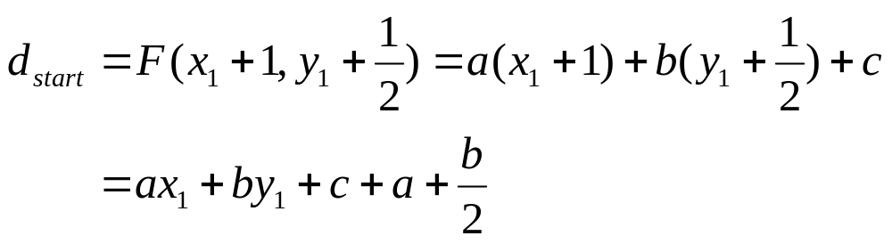
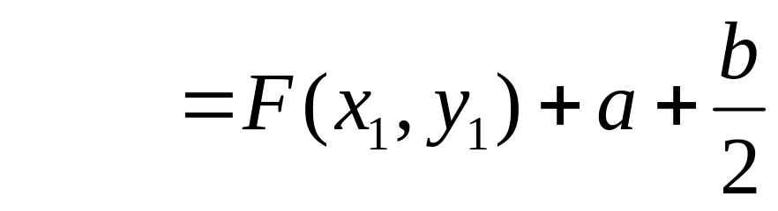
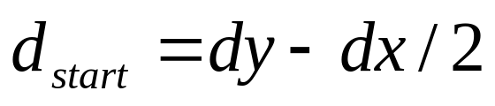
Initial value of d.
Start point is (x1,y1)
But (x1,y1) is a point on the line, so F(x1,y1) =0
Conventional to multiply by 2 to remove fraction ⇒ doesn’t effect sign.

Slide 19
Bresenham algorithm
void MidpointLine(int x1,y1,x2,y2)
{
int dx=x2-x1;
int dy=y2-y1;
int d=2*dy-dx;
int incrE=2*dy;
int incrNE=2*(dy-dx);
x=x1;
y=y1;
WritePixel(x,y);
while (x < x2) {
if (d<= 0) {
d+=incrE;
x++
} else {
d+=incrNE;
x++;
y++;
}
WritePixel(x,y);
}
}

Slide 20
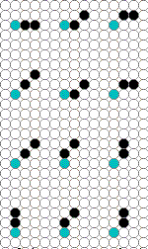
Bresenham was not the end!
2-step algorithm by Xiaolin Wu:
(see Graphics Gems 1, by Brian Wyvill)
Treat line drawing as an automaton , or finite state machine, ie. looking at next two pixels of a line, easy to see that only a finite set of possibilities exist.
The 2-step algorithm exploits symmetry by simultaneously drawing from both ends towards the midpoint.

Slide 21
Two-step Algorithm
Possible positions of next two pixels dependent on slope – current pixel in blue:
Slope between 0 and ½
Slope between ½ and 1
Slope between 1 and 2
Slope greater than 2

Slide 22
Circle drawing.
Can also use Bresenham to draw circles.
Use 8-fold symmetry
E
M
SE
Previous
Pixel
Choices for
Current pixel
Choices for
Next pixel

Slide 23
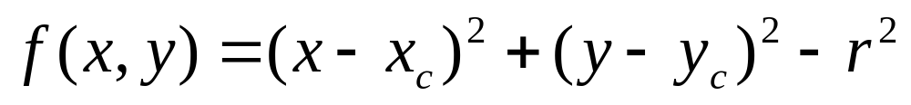
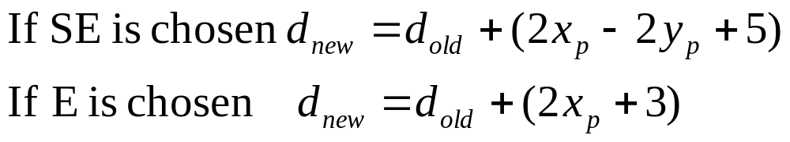
Circle drawing.
Implicit form for a circle is:
      Functions are linear equations in terms of (xp,yp)
        Termed point of evaluation

Slide 24
Problems with Bresenham algorithm
Pixels are drawn as a single line ⇒ unequal line intensity with change in angle.
Pixel density = √2.n pixels/mm
Can draw lines in darker colours according to line direction.
- Better solution : antialiasing !
Pixel density = n pixels/mm

Slide 25
Summary of line drawing so far.
Explicit form of line
  Inefficient, difficult to control.
Parametric form of line.
  Express line in terms of parameter t
  DDA algorithm
Implicit form of line
  Only need to test for ‘side’ of line.
  Bresenham algorithm.
  Can also draw circles.

Slide 26
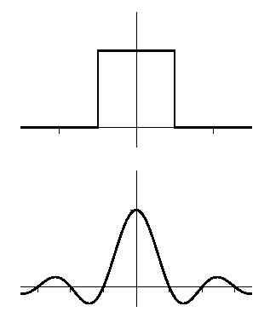
Summary of aliasing.
Sampling theory tells us aliasing is caused by frequencies being present above the Nyquist limit.
Ideal solution : band-pass filter to remove high frequencies.
Fourier transform tells us the transform of a band-pass filter is a sinc function.
Convolution theory tells us we can convolve with a sinc function in the spatial domain instead.
A sinc function is an impractical filter.
Notes:
This is all you need to know on aliasing.

Slide 27
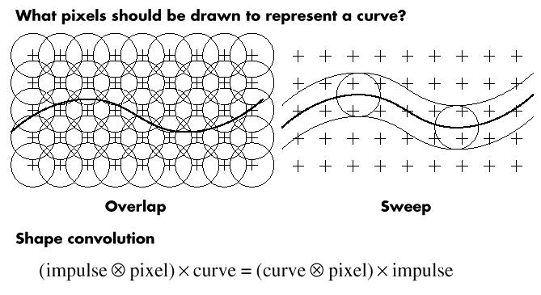
Antialiasing
Two ways of antialiasing
Gather all the values into the pixels
Loop round the pixels.
Used for complex scenes.
Cast out rays, convolve result into pixel
(Pixel Grid ⊗ Impulse) x line
Notes:
Not examinable.

Slide 28
Antialiasing
Two ways of antialiasing
Scatter values into the pixels
Loop along the line.
If line is delta function, we just sweep the pixel filter along the line
(Line ⊗ Pixel) x impulse

Slide 29
Antialiasing lines.
Obvious : Need a grey level display in order to remove aliasing.
Convolve line with filter function for pixel
  Box filter ⇒area sample
  Convolution with conical filter function.
Price to be paid : trade off spatial resolution
  Line appears more ‘blurred’, it’s exact position is no longer as well defined.
  In practice : contrast of lines much reduced.
1 pixel

Slide 30
Antialiasing by area sampling.
Convolve line with box filter function
⇒ Draw line as thin rectangle.
Calculate area of square pixel covered by line
Problem :
Equal areas contribute equal intensity, regardless of distance from line centre
Small area in the pixels centre contributes as much as a small area at the pixels edge.

Slide 31
Weighted area filtering.
Convolution with a conical filter.
Easy to compute, symmetrical.
Lines are same distance
from pixel centre, but
area of pixel covered is
very different in the square case

Slide 32
Weighted area filtering.
Diameter is 2 pixels, so overlap occurs
  Ensures all of the grid is covered
Area is normalised
Only need to know distance from pixel centre to line
Gupta-Sproull algorithm.

Slide 33
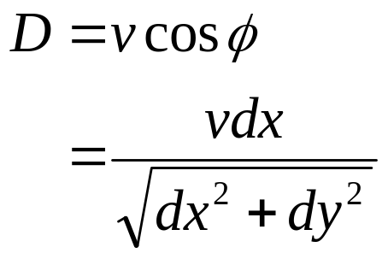
Gupta-Sproull algorithm.
Calculate distance using features of mid-point algorithm
dy
NE
dx
v
Angle = ∅
M
D
E
Notes:
Only principle of this method important.

Slide 34
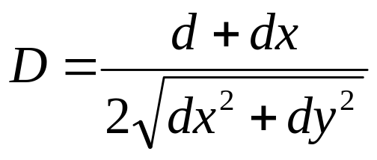
Gupta-Sproull algorithm.
Calculate distance using features of mid-point algorithm
See Foley Van-Dam
Sec. 3.17
d is the decision variable.

Slide 35
Filter shape.
Cone filter
  Simply set pixel to a multiple of the distance
Gaussian filter
  Store precomputed values in look up table
Thick lines
  Store area intersection in look-up table.

Slide 36
Summary of antialiasing lines
Use square unweighted average filter
  Poor representation of line.
Weighted average filter better
Use Cone
  Symmetrical, only need to know distance
  Use decision variable calculated in Bresenham.
  Gupta-Sproull algorithm.

Slide 37
Polygon Surface

Slide 38
Polygon Surfaces
Basic form of representation in most applications – all real-time displays.
Easy to process, fast to process.
Some applications may allow other descriptions, eg. Splines, but reduce all objects to polygons for processing.
Fits easily into scan-line algorithms.

Slide 39
Simple scan conversion
May need to fill the polygon with colour.
Incorporate in a scan conversion algorithm.
Find intersection points for scan-line, update is -1/g in a top to bottom scan.
We may not be drawing actual pixels due to antialiasing, so we say we tile the polygon with pixel ‘fragments’.
Start
Finish
Scan line

Slide 40
Types of polygons.
Types
• Triangles
• Trapezoids
• Quadrilaterals
• Convex
• Concave
• Self-intersecting
• Multiple loops
• Holes
Convex
Concave
Self –
intersecting
Hole
Two approaches :
Generalise scan conversion
Split into triangles.
Notes:
Only convex and concave polygons important.

Slide 41
Definitions.
A polygon is convex if: for all edges, all other vertices lie on the same side of the edge.
Otherwise it is concave.
Concave polygons can be difficult to process.
Convex
Concave

Slide 42
Triangles are Always Convex
Mathematically very simple – involving simple linear equations.
Three points guaranteed coplaner.
Any polygon can be decomposed into triangles.
Triangles can approximate arbitrary shapes.
For any orientation on screen, a scan line will intersect only a single segment (scan).

Slide 43
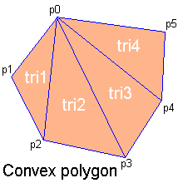
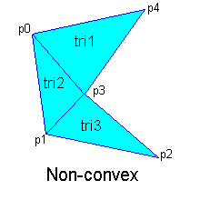
Any polygon decomposes
Convex polygons trivially decompose but non-convex polygons are non-trivial and in some overlapping or intersecting cases, new vertices have to be introduced.

Slide 44
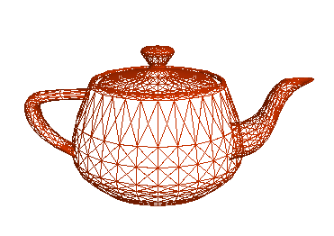
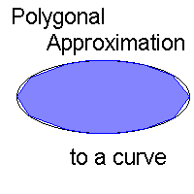
Arbitrary shapes with triangles
Any 2D shape (or 3D surface) can be approximated with locally linear polygons. To improve, need only increase no. of edges

Slide 45

Quadrilaterals are simple too and often mixed with triangles

Slide 46
How do we represent polygons?
Polygonal Geometry.
Store all polygon vertices explicitly.
Inefficient
Cannot manipulate vertex positions.
E3
V1
P2
E1
P1
E2
V2
V3
Notes:
Quite important storing polygonal geometry.

Slide 47
Representing Shapes.
Polygonal Geometry.
Store all polygon vertices explicitly.
Inefficient
Cannot manipulate vertex positions.
V1
E3
P1
E1
P2
Use pointer into vertex list.
Need to search to find adjacent polygons.
Edges are drawn twice.
Use pointer to edge list that points to vertex list.
E2
V2
V3

Slide 48
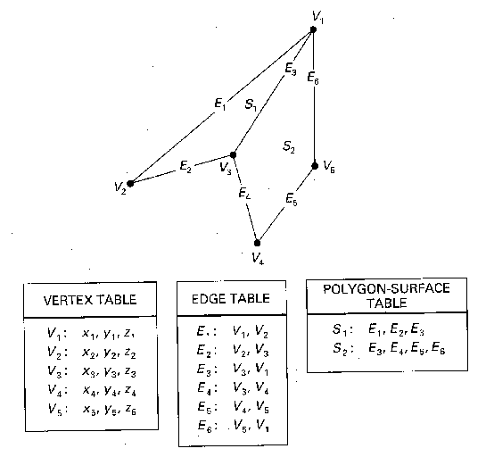
Standard polygonal data structure

Slide 49
Filling, or ‘tiling’ a triangle.
Calculate bounding box for triangle.
Loop through pixels in box
Test for lying inside the triangle
Draw fragment if inside box
Bounding box

Slide 50
Triangle tiler.
tile3( vert v[3] )
{
int x, y;
bbox b;
bound3(v,&b); // calculate bounding box
for( y=b.ymin; y<b.ymax, y++ )
for( x=b.xmin; x<b.xmax, x++ )
if( inside3(v,x,y) )
draw_fragment(x,y);
}
Bounding box
Notes:
The code is to illustrate the method – don’t need to know it !

Slide 51
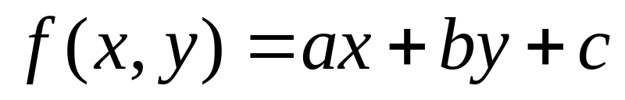
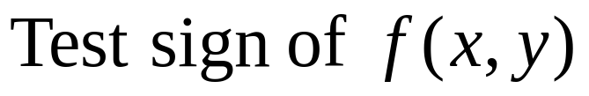
Testing for inside a triangle.
Write equation for all edges in implicit form
Need to order vertices in consistent order so inside the polygon is on same ‘side’ of line.
Can terminate test early if point fails with an edge.

Slide 52
Incremental triangle Tiler
tile3( vert v[3] ) {
int x, y;
bbox b;edge l0, l1, l2; float e0, e1, e2;
make_edge(&v[0],&v[1],&l2); // Calculate a,b & c for the edges
make_edge(&v[1],&v[2],&l0);
make_edge(&v[2],&v[0],&l1);
bound3(v,&b); // Calculate bounding box
e0 = l0.a * b.xmin + l0.b * b.ymin + l0.c; // Calculate f(x,y) for
e1 = l1.a * b.xmin + l1.b * b.ymin + l1.c; // the 3 edges.
e2 = l2.a * b.xmin + l2.b * b.ymin + l2.c;
for( y=b.ymin; y<b.ymax, y++ ) {
for( x=b.xmin; x<b.xmax, x++ ) {
if( e0<=0 && e1<=0 && e2<=0 ) draw_fragment(x,y); // Draw if
e0 += l0.a; e1 += l1.a; e2 += l2.a; // inside triangle
}
e0 += l0.a * (b.xmin - b.xmax) + l0.b; // same for e1 & e2.
}
}
Notes:
Code is not important – just the algorithm

Slide 53
Gaps and Singularities.
Missed pixels
(slivers)
Common edge between polygons,
(drawn twice?)

Slide 54
What to do with common edges
Draw a fragment
  Problem : double hits.
  Wasted effort
  Problem when it comes to transparency, blending or complex operations.
Don’t draw a fragment.
  Gaps?
  Rule: draw pixels on left and bottom edges

Slide 55
Gaps
Solution : shadow test
Left as an exercise.

Slide 56
Summary
Test for point inside triangle by testing point with implicit form of edges.
Problem with gaps.
Problem with concave polygons.

Slide 57
Polygon decomposition into triangles.
Now that we have an ‘inside’ test, we can convert polygons to triangles.
  Triangles simple, convex and planar.
P6
Simple for convex polygons.
P7
P5
Concave more difficult.
P4
P0
P1
P3
P2

Slide 58
Polygon decomposition
Test all vertices to check they are outside of ABC.
  Test one edge at a time to reject vertices early
B
D
C
Vertex ‘D’ fails test.
A

Slide 59
Polygon decomposition
If all vertices outside ⇒ store triangle, remove vertex and proceed with next leftmost vertex.
If a vertex is inside, form new triangle with leftmost inside vertex and point A, proceed as before.
B
D
Test ABD in same manner as before,
C
A

Slide 60
Jordan Curve Theorem.
Another test for inside/outside of a polygon.
Two definitions of inside :
Even-Odd parity
Winding number
4
3
2
0
1
Even no. crossings : Outside polygon
Odd no. crossings : Inside polygon.
Notes:
Important theorem.

Slide 61
Jordan Curve Theorem.
4
3
2
0
Even no. crossings : Outside polygon
Odd no. crossings : Inside polygon.
1
2
0
4
1
3
Doesn’t work for self-intersecting polygons

Slide 62
Jordan Curve Theorem.
Non-zero Winding Number
Use direction of line as well as crossing
Set a value, e = 0
For right-left crossings, e + +, for left-right e - -
For inside, e != 0
2
0
1
0
0
0
1
1
1

Slide 63
Singularities
Two types of singularity in Jordan curve algorithm :
Horizontal line along scanline
Edge passes through point.
These represent limiting cases of a fill.

Slide 64
Scanline algorithm.
Incremental Jordan test.
Sort vertex events according to y value.
y

Slide 65
Scanline algorithm.
Incremental Jordan test.
Sort vertex events according to y value.
Treat each vertex as an edge ‘event’, i.e a change of edge crossing the scanline.
Use ‘scanline coherence’, i.e the value for the previous scanline is very similar to the next.
Maintain ‘active edge’ list.

Slide 66
Active edge list.
Vertices are ‘events’ in the edge list – edges become active, inactive or are replaced by other edges.
Sort intercepts by x crossing.
Output span between left and right edge.
Create
y
Replace
Delete
Notes:
Important method.

Slide 67
Triangle Tiler
2
struct edge
{
int x ; // x intercept of a point on
// the line.
// y coord is assumed to be
// current scanline
float dxdy ; // dx/dy for the line
}
struct vert
{
int x ;
int y ;
}
y
1
0
Assume :
Vertices already sorted
Single left hand edge
- Why use dx/dy ? So we can loop over y and increment x by dx/dy at
each interval, since y increments bottom to top.

Slide 68
Triangle Tiler
2
scany( vert v[3]) {
ybot = ceil(v[0].y);
ymid = ceil(v[1].y);
ytop = ceil(v[2].y);
// Make edges. l is left edge, r is right
mkedge(&v[0],&v[2],&e1,ybot);
mkedge(&v[0],&v[1],&e2,ybot);
mkedge(&v[1],&v[2],&e0,ymid);
l=e1; r=e2;
for( y=ybot; y<ytop; y++ ) {
if( y >= ymid ) r = e0;
scanx(&l,&r,y);
l.x += l.dxdy;
r.x += r.dxdy;
}
}
e0
e1
1
e2
0
Assume :
Vertices already sorted
Single left hand edge

Slide 69
Triangle Tiler
t
mkedge(vert *b, vert *t, edge *e, int y)
{
e->dxdy = (t->x - b->x) / (t->y - b->y);
e->x = b->x + (y - b->y) * e->dxdy;
}
e->x
y
b
scanx( edge *l, edge *r, int y)
{
lx = ceil(l->x);
rx = ceil(r->x);
for( x=lx; x<rx; x++ )
fragment(x,y);
}

Slide 70
Summary
Perform Jordan test incrementally.
Keep list of ‘active’ edges.
Fill from left to right edge at each scanline
Use equation of line to increment position of edge.

Slide 71
How do we draw triangles faster?
Represent triangle as 3 vertices and 3 edges.
If we’re performing a transformation on the triangle, we need to transform the position of 3 points.
⇒ 3 matrix operations per triangle

Slide 72
Triangular fans.
Triangles used in complex polygonal geometry.
Triangular Fan.
To add new triangle, only 1 vertex needs to be added.
Red - existing vertices.
Black - new vertex
Notes:
Important methods for drawing.

Slide 73
Tri-strip
Use triangles to represent a solid object as a mesh.
Triangles frequently appear in strips :
A new triangle is defined by 1 new vertex added to the strip.

Slide 74
How do we draw triangles faster?
For tri-strips and fans, only need to transform position of 1 point per triangle.
  1 matrix operation per triangle.
  Much faster !
Also Quad-strip - 2 vertices per quad

Slide 75
Summary
Triangles
  3 matrix operations per transformation.
Triangle Fan
  Connected group sharing 1 common vertex, and 1 from previous triangle.
  1 matrix operation per transformation.
Tri-strip.
  Group of triangles sharing 2 vertices from previous triangle.
  1 matrix operation per transformation.

Slide 76
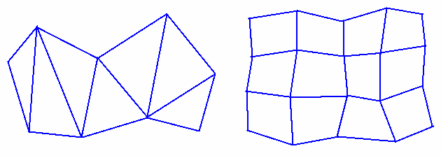

Slide 77
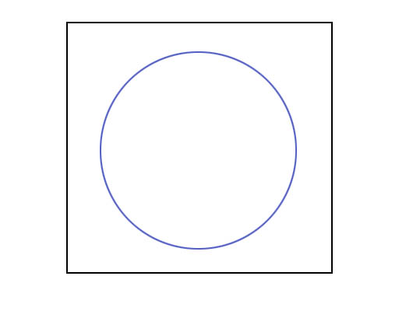

Slide 78
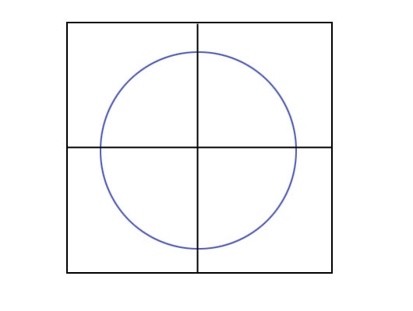

Slide 79
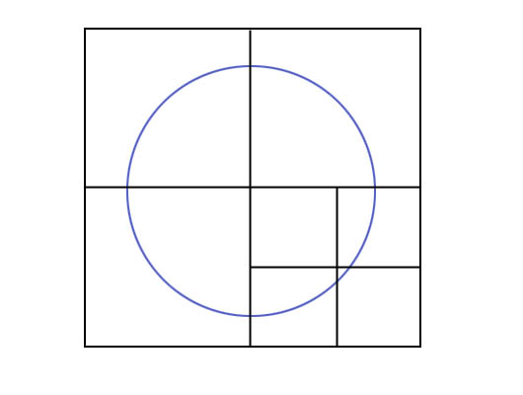

Slide 80
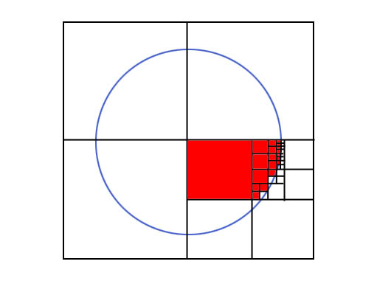

Slide 81
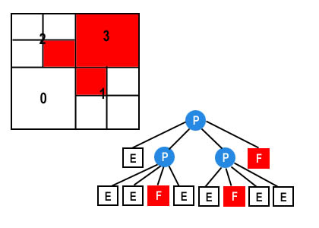

Slide 82
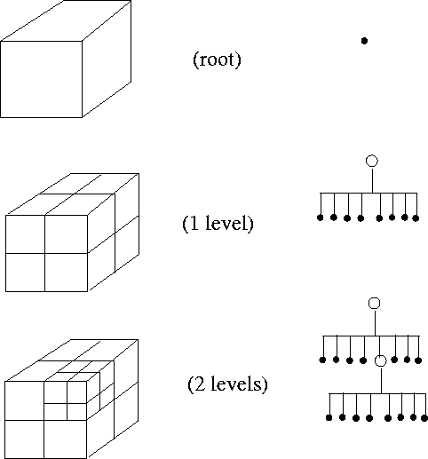
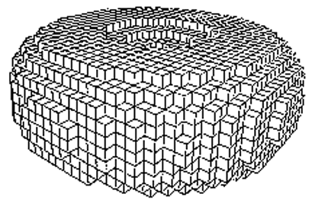

Slide 83
